Slide 1
Click Here to Begin

Slide 2
Instructions
You will be completing a Logic Grid Puzzle.
First you will read the story, and then click the blue arrow in the bottom right to continue to the puzzle.
After you have completed the puzzle click the blue arrow in the bottom right to continue.

Slide 3
Story
Three friends went to an Italian restaurant and had dinner. Each person ordered a different type of meal (pizza, ravioli, spaghetti), a different drink (iced tea, lemonade, soda) and a different dessert (cake, cannoli, tiramisu). Using only the clues provided on the next page, determine which meal, drink and dessert were ordered together.

Slide 4
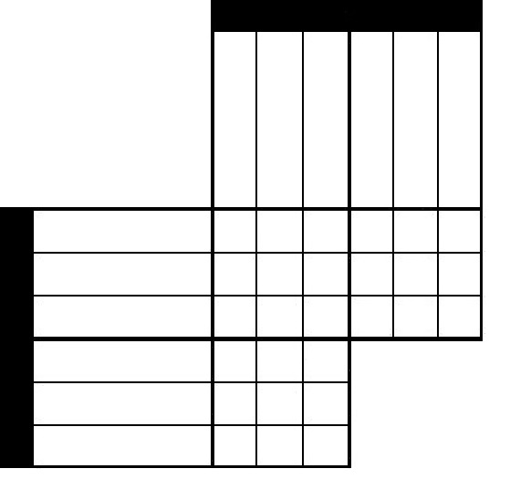
Clues
Click on your selection:
Key:
X = False
O = True
X
O
Erase
Clue 1) The same person who ordered the cake ordered the pizza.
Clue 2) The person who ordered the lemonade did not order the spaghetti.
Clue 3) The three orders were: the one that ordered the tiramisu, the one with the pizza, and the one with the lemonade.
Clue 4) Neither the person who ordered the cannoli, nor the person who ordered the spaghetti had the soda.
Clue 5) Of the person who ordered the cannoli, and the person who ordered the cake, one ordered the ravioli, and the other had the soda.
You have selected X
Meal
Drink
Pizza
Ravioli
Spaghetti
Iced Tea
Lemonade
Soda
Dessert
Cake
Cannoli
Tiramisu
Iced Tea
Drink
Lemonade
Please complete the grid and solve the puzzle.
Once you have finished it, click the blue forward arrow.
Soda

Slide 5
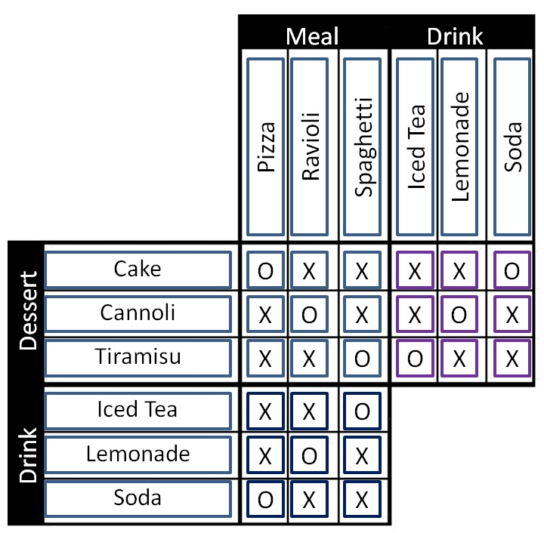
Logic Puzzle Answers
Correct Answers:
You got
out of 27 cells correct!
The correct answers were:
Pizza…Cake…Soda
Ravioli…Cannoli…Lemonade
Spaghetti…Iced Tea…Tiramisu

Slide 6
This part of the assessment is complete. Please click on the arrow to continue.

